Slide 1
Business Analytics I
“Core Summit” Presentation
Professor Mike Mazzeo
21 May 2013

Slide 2
Kellogg’s Business Analytics Core
Working Assumption: Today’s MBA graduates will need a deep understanding of analytics for career success.
Working Definition: Analytics is “the discovery and communication of meaningful patterns in data”
The core sequence will provide students with an analytics tool kit, emphasizing the value and pitfalls of reasoning with data.
Applications will emphasize the connections among analytical tools, data and business decision-making.

Slide 3
This Course: Business Analytics I
We will review and reinforce the basic tools of statistics and probability that were presented in the on-line pre-course.
We will focus on analytical reasoning skills critical for using data in a business context:
Independence
Sampling
We will work on increasing students’ ability to work with data and understand the conclusions made from data analysis.
Note: Course development still in progress – will likely continue until the pre-term begins…

Slide 4
Motivation: Using Data to Guide Investments
Netflix originally began as a mail-order
DVD service that competed with firms
such as Blockbuster Video.
As internet penetration and download
speeds have increased, streaming of
movies has become a more important
channel in the industry.
The internet streaming channel is
potentially much more competitive,
as distribution costs are substantially
reduced.
Access to content (i.e., movies and
other programming) that consumers
find attractive will be more and more
critical to obtain/retain subscribers.

Slide 5
Motivation: Using Data to Guide Investments
Question: How does Netflix make its content acquisition choices in the internet streaming world?
Issue: Consumer preferences likely vary by distribution channel – popular theatrical releases vs. at-home viewing
Opportunity: Netflix has access to extensive, detailed data on the viewing choices and pattern of its subscribers.

Slide 6
Motivation: Using Data to Guide Investments

Slide 7
Motivation: Using Data to Guide Investments
2012 Movie Box Office Top 5

Slide 8
Motivation: Using Data to Guide Investments
Netflix can record and log data “events”
associated with its subscribers’ use of
the video streaming services.
As a result, it has extensive information
about how the viewing habits of its
subscribers may differ from those of
consumers overall.
For example, data indicated popularity
of movies starring Kevin Spacey and
directed by David Fincher.
This motivated Netflix to spend $100
million to produce “House of Cards”
for exclusive Netflix distribution. Its
following quarterly results indicated
a 7 percent increase in subscribers.

Slide 9
Motivation: Pervasive Trend of Companies using Data to Make Decisions and Solve Problems
Nest Labs: sells thermostats that control heating/cooling systems using data on consumption and weather to operate more efficiently
Kenexa: purchased by IBM for $1.3 billion in 12/2012, the company analyzes data from 40 million job applicants, workers and managers per year to provide insights about companies’ HR strategies
Kaggle: startup that finds patterns in large datasets that are potentially useful to consumers and firms (e.g., odd colored used cars have fewer post-purchase problems!).

Slide 10
Homework Example: Bad Debt and Conditional Probability

Slide 11
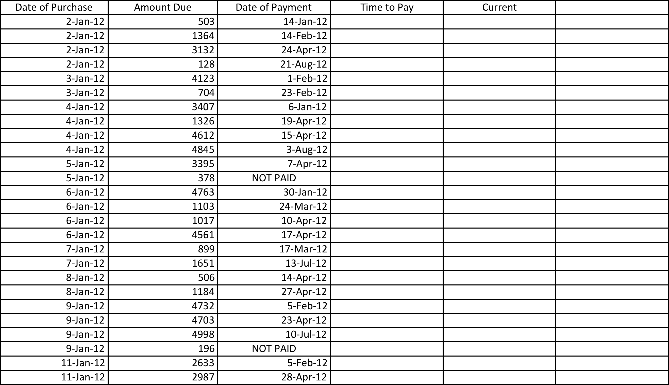
Homework Example: Bad Debt and Conditional Probability

Slide 12
Syllabus and Course Logistics (Details TBD)
Class Session #1 – Statistics and Probability Basics
Descriptive statistics, uncertainty, conditionals, ACCT bad debt
Class Session #2 – Independence Basics
Random variables, rules of mean and variance, FIN portfolios
Class Session #3 – Independence Challenges
Covariance and correlation, central limit theorem
Class #4 – Sampling Basics
Sample vs. population, confidence intervals, hypothesis testing
Class #5 – Sampling Challenges
Sample bias, adverse selection, annuities application
Class #6 – Final Exam

Slide 13
Syllabus and Course Logistics (Details TBD)
ABL 1 will run roughly every other day during the pre-term (along with MORS each day)
Students will work on data oriented problem sets in between class sessions.
Pre-term Faculty: PJ Lamberson
Mike Mazzeo
Brett Saraniti
Jim Schummer
New version of the course will also be offered in the part-time program.

