Slide 1
ACCT 430 Accounting for Management Decisions
Core Course Summit
21 May 2013
Bob Magee

Slide 2
Course Objectives
General: To develop the ability to analyze, interpret and use financial statements.
Specific:
To understand and use the financial reporting system’s interconnected structure
To develop and test hypotheses about an organization’s activities and to forecast future outcomes
To recognize the incentives for and effects of managerial discretion in accounting methods, estimates and transactions.

Slide 3
Financial Statements
Balance sheet (at a point in time)
Assets (resources)
Liabilities and shareholders’ equity (claims on resources)
Income statement (over a period of time)
Revenues (inflows of net resources from operations)
Expenses (outflows of net resources from operations)
Statement of cash flows (over a period of time)
Operating
Investing
Financing
Statement of stockholders’ equity (over a period of time)
Footnotes/Management Discussion and Analysis

Slide 4
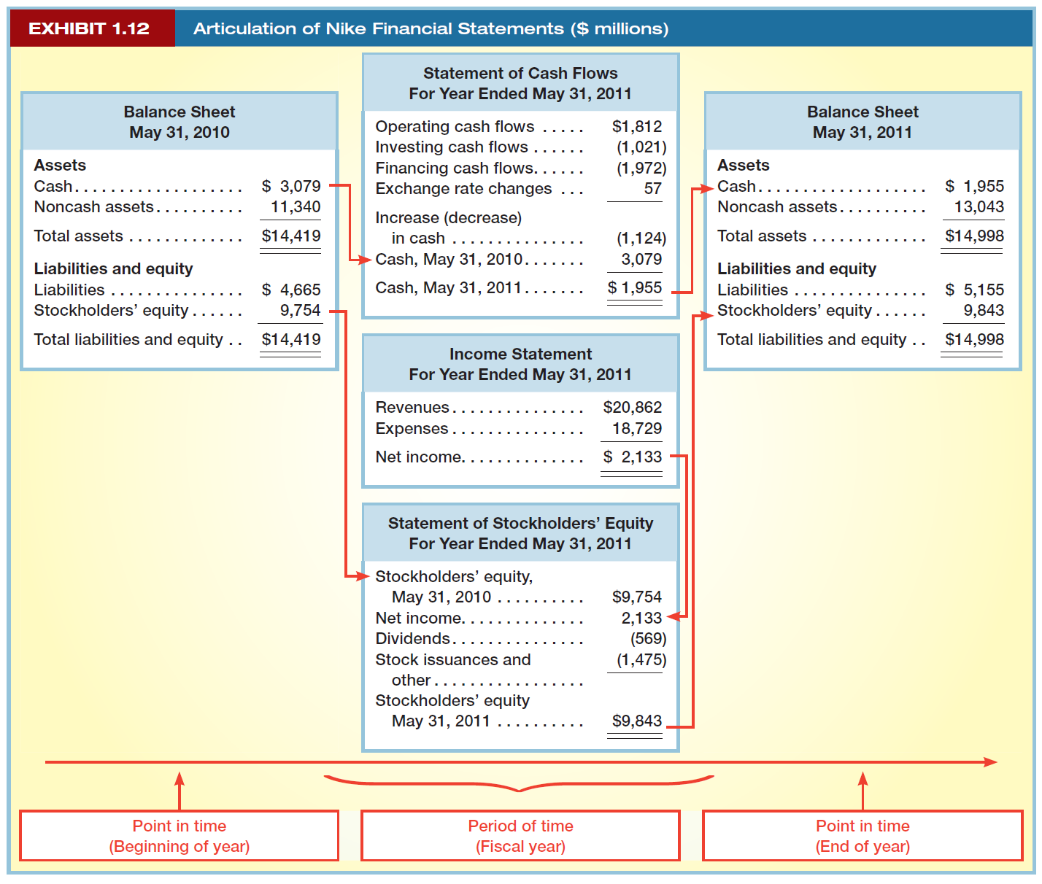

Slide 5
A simple recording format (FSET)
Emphasize the relationship between BS and IS
Simple transactions:
(We do use debits and credits and T-accounts, but the FSET provides an intuitive beginning to the accounting process.)

Slide 6
Income statement effects
IS effects are echoes of changes in the balance sheet. The “entry” is in blue, and the “effects” are in black.
Each transaction maintains the balance in the system.
Transactions and adjusting entries (like depreciation) must be entered.

Slide 7
Following steps
Record all the entries (transactions and adjustments), sum them up and put them in a presentation format
Produce the income statement
Produce the balance sheet
Create the statement of cash flows
Operating (cash from customers, cash paid to suppliers and employees and tax authorities)
Investing (capital expenditures, investments in securities)
Financing (issuing and repaying debt, issuing and repurchasing stock, paying dividends)
Create the statement of shareholders’ equity

Slide 8
Analyze and interpret
Simple ratios
Profitability (ROE, ROA, Gross Margin, etc.)
Liquidity (Current Ratio, Receivable and Inventory Turnover, etc.)
Solvency (Debt-to-Equity Ratios, Coverage Ratios, etc.)
Finding appropriate benchmarks
How do transactions affect ratios?
Interpretation
Reverse engineering

Slide 9
Sample exam question - 1
The income statement and indirect method operating cash flows from Peerless Corporation’s reports to shareholders are as follows:
For the period above:
How much cash did Peerless collect from its customers?
How much cash did Peerless pay for income taxes?
Income statement
Revenue | $400
Cost of goods sold | 215
Gross profit | 185
Operating expenses | 110
Operating income | 75
Interest expense | 25
Income before taxes | 50
Income tax expense | 15
Net income | $ 35
Cash from operations
Net income | $ 35
Plus depreciation expense | 70
Operating asset adjustments
Less increase in accounts receivable | -25
Less increase in inventories | -50
Less increase in prepaid rent | -5
Plus increase in accounts payable | +65
Plus increase in income tax payable | +5
Cash from operations | $ 95

Slide 10
Sample exam question-2
On March 9, 2013, the Chicago Tribune reported that Accretive Health, Inc. (a fast-growing Chicago-based hospital billings and collection management company) announced that it had incorrectly accounted for its revenue for at least nine fiscal quarters and investors “should not rely on its financial statements for the 2009, 2010 and 2011 fiscal years.” Accretive expects that the restatements “will have no effect on total revenue booked over the life” of its contracts with clients.
As part of its announcement, Accretive Health also said that the restatements “could lead to increases in future revenue.” What is the most likely reason for such a projection about future revenue?
(a) The restatement announcement would make Accretive Health more attractive to potential clients in the future.
(b) Accretive Health has been too conservative in its accounting for revenue in the past (i.e., it recognized less revenue than it should have) and fixing that will increase future revenue.
(c) If Accretive Health has recognized revenue too early in the past, correcting that error will reduce past revenue, and the corrected accrual process will allocate more revenue to future periods.
(d) Once Accretive Health identifies the culprits, and they are properly chastised, everyone will work harder to make the company look good.

Slide 11
Financial reporting incentives
Managers may want to produce financial reports with favorable (or, occasionally, unfavorable) outcomes.
Stock price
Borrowing relationships
Covenants
Performance pricing
Incentive compensation
“Big bath”
Cost-based contracting
Fund-raising (NFPs)

Slide 12
Financial reporting discretion
Management discretion can take many forms
Accounting methods
LIFO/FIFO
Accounting estimates
Bad debt expense
Fair values (write-downs, acquisitions, investments)
Transaction choice
Product characteristics
Financial investments
Off-balance-sheet financing (and investing)
Transaction timing
Sale of assets (physical or financial)
Need to be cautious in interpreting ratios and financial results.

Slide 13
Example: Revenue recognition
Four requirements must be met before revenue can be recognized
Persuasive evidence of an exchange agreement exists, and
Delivery of goods and/or services has occurred, and
Price is fixed or determinable, and
Collectability is reasonably assured.
Examples of cases where cash comes before delivery
Airlines
Lyric Opera
“Sales to customers” ≠ Revenue

Slide 14
Zynga prospectus prior to its IPO
“For the sale of consumable virtual goods, we recognize revenue as the goods are consumed. Durable virtual goods, such as tractors in FarmVille, represent virtual goods that are accessible to the player over an extended period of time. We recognize revenue from the sale of durable virtual goods ratably over the estimated average playing period of paying players for the applicable game, which represents our best estimate of the average life of our durable virtual goods…For the six months ended June 30, 2011, the estimated average playing period of paying players for our games ranged from eight to 25 months.”
Example: Customer pays $12 for a durable asset in a game with average play of 12 months.
 | Balance Sheet |  |  |  |  |  |  |  |  | Income Statement
 | Cash Asset | + | Noncash Assets | = | Liabilities | + | Cont’d Cap | + | Earned Capital | Revenues | - | Expen-ses | = | Net Income
Receive Cash | +12 Cash | + |  | = | +12 Unearned revenue |  |  |  |  |  | - |  | =
Each of next 12 months |  |  |  |  | -1 Unearned revenue |  |  |  | +1 Retained earnings | +1 Revenue | - |  | = | +1

Slide 15
Effects of this accounting
Each month’s revenue is an average of sales made to customers over the past months.
Subject to estimation changes
Not a great indicator of this month’s customer transactions
In its prospectus, Zynga reported revenue growth of 126% from first half of 2010 to first half of 2011.
BUT, the average gaming duration went from 14 months in 2010 to 11 months in 2011. Without this change, revenue growth would have been 114%.
AND, reverse engineering shows that customer purchases grew by 50% from first half of 2010 to first half of 2011.

Slide 16
Successful ACCT 430 students should be…
Able to construct financial statements from historical or planned activities. (BS, IS and SCF that balance and “articulate.”)
Able to calculate and interpret standard financial ratios and other comparisons.
Be aware of common adjustments that need to be made
Able to formulate and test hypotheses about organizations’ underlying activities based on financial information.
Able to understand the valuation and contracting implications of accounting reports and the incentives for management to affect them.

