Slide 1
NASSCOM Social Innovation Honors [NSIH]: Evaluation and Recommendations

Slide 2
Agenda
Introduction of NASSCOM, NF and NSIH
Questions facing NSIH and Approach
Expectations and Needs Identified
Recommendations for these Expectations and Needs

Slide 3
NASSCOM – The National Association of Software and Services Companies
Trade body and chamber of commerce for the IT-BPO Industry in India
Various roles include advocacy on public policy, international trade development, and research and market intelligence services
Over 1200 members, including both Indian companies and multinational organizations

Slide 4
NASSCOM Foundation
In 2003, NASSCOM Foundation was created with the goal of leveraging ICT for the social sector
Microsoft
NASSCOM Foundation
Nonprofit
Donates technology such as computers and other hardware
Improves and distributes technology
Utilizes technology for social impact

Slide 5
The NASSCOM Social Innovation Honors
Recognizes excellence in ICT innovation for a social purpose across seven types of organizations
Process culminates in a ceremony where shortlisted organizations receive advice on their project, interact with IT industry executives, and gain recognition in the IT community for their work
Seven NSIH categories
Non Profit
For Profit
CSR
Multi - Stakeholder
Government
Individual
Student

Slide 6
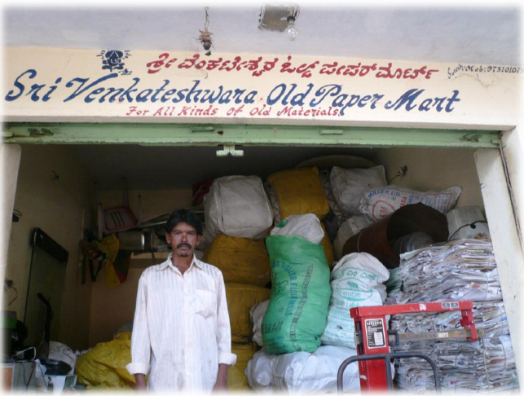
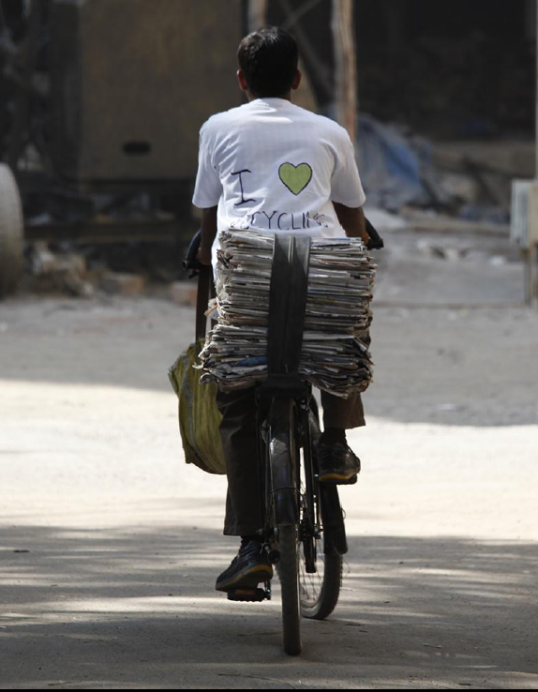

The Kabadiwala Project
Problem
Approach
Move from household to household purchasing waste in the form of recyclables which are then sold to a middleman at a small profit
  Suffer from lack of organization, efficiency, and low status within society
Empower these workers and ensures greater recycling efficiency through an online portal and SMS solution connecting Kabadiwalas to households and middlemen
Provide electronic scales to ensure fair, transparent pricing
Encourage households to segregate wet/dry waste

Slide 7
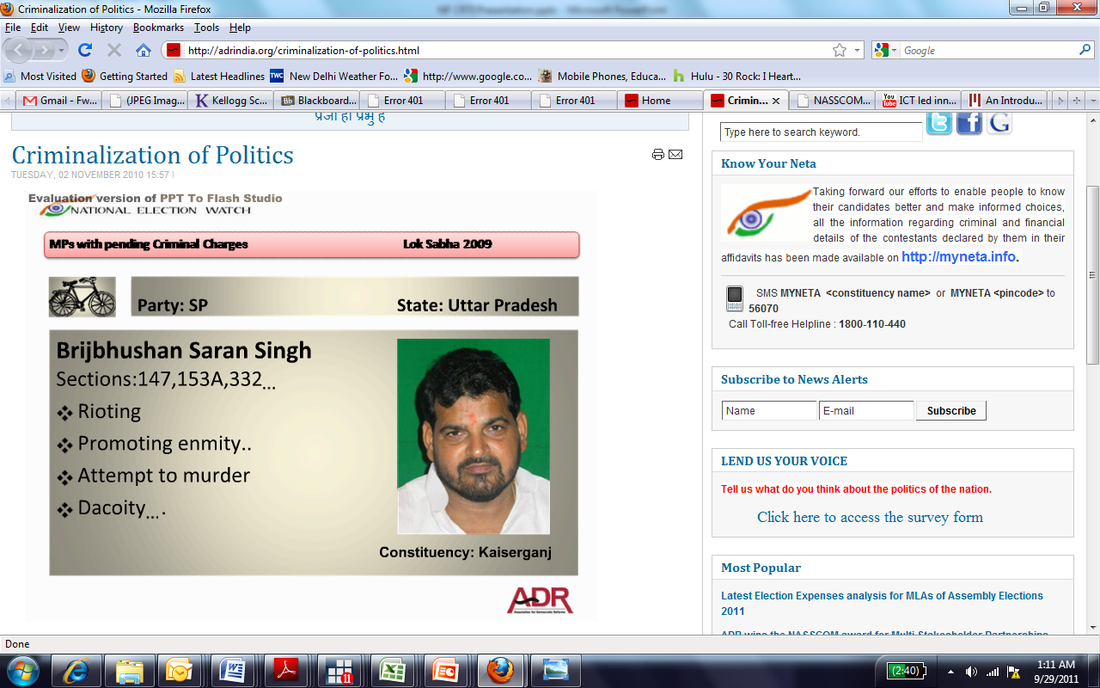

Association for Democratic Reform (ADR)
Problem
Approach
Publish the criminal records and assets of all candidates running for office several days before elections begin, providing enough time to create awareness of criminal history of candidates among voters
Available online, via SMS, and through a hotline
2009 Lower Parliament elections (Lok Sahba) - 29% of candidates had pending criminal charges, of which 13% were serious
Inclusive of murder, extortion, attempted murder, bribery and more
Some candidates in states such as Bihar and Uttar Pradesh had over 100 pending charges

Slide 8
Agenda
Introduction of NASSCOM, NF and NSIH
Questions facing NSIH and Approach
Expectations and Needs Identified
Recommendations for these Expectations and Needs

Slide 9
Questions NF would like to address
NF Context
NF Question
In the past NF has not kept in touch with winners and therefore cannot leverage their individual strengths to create a community
  How can we bring our diverse set of NSIH
  winners together?
    What are common traits that they share?
NF wants to showcase the progress of NSIH winners in order to create awareness of the program and attract more applicants
How can we best showcase the progress of the organizations thus far?

Slide 10
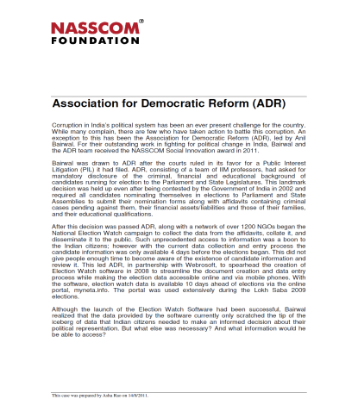
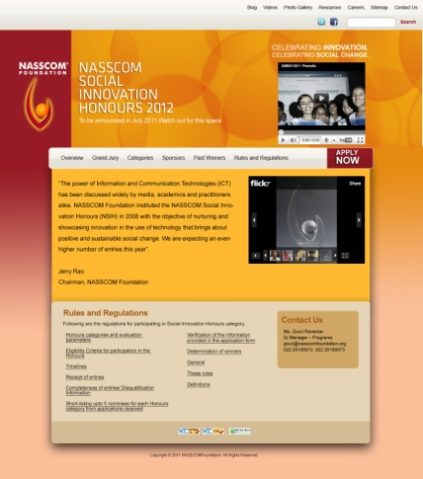
Solutions to the NF questions
NF Question
Solution
How can we bring our diverse NSIH community together?
How can we bring our diverse NSIH community together?
Provide workshops on business development and innovation
Create networking opportunities
Provide access to grant listings
Provide workshops on business development and innovation
Create networking opportunities
Provide access to grant listings
How can we create awareness of the program and showcase the progress of the organizations?
Created case studies analyzing the success of three winners
Aided the redesign of the NSIH website

Slide 11
Conducted 30 phone interviews across the seven NSIH categories to identify themes
Gaon Ki Awaaz
SMSone
Swanchetan
Educomp
Small Organizations
<10 Employees
Large
Organizations
Association for Democratic Reform
Sarvajal
IBM
Illustrative

Slide 12
Expectations identified from the interview Process
Expectations for Smaller organizations
Funding (Grants, Investments, Loans, Cash Prize)
Mentorships
Business advice
Small Organizations
Large
Organizations
Common Expectations across all organizations
Visibility
Partnerships [Corporate, Government, Peer to Peer]
Networking Opportunities

Slide 13
Key insights from online survey results
The most articulated need is for grants, followed by business development, networking and innovation

Slide 14
Agenda
Introduction of NASSCOM, NF and NSIH
Questions facing NSIH and Approach
Expectations and Needs Identified
Recommendations for these Expectations and Needs

Slide 15
Build community by offering solutions to organizations’ needs
Addressing Expectations
High
Net-
working
Event
Workshops
Business
Develop.
Workshop
Innovation
Workshop
Fundraising
1st Priority
Exclusive
Grant listing
2nd Priority
Media
Exposure
Loan
Assist-
ance
3rd Priority
Cash
Prize
Mentorships
Low
Low
Ease of Implementation
High

Slide 16
Next steps for NF
Create networking opportunities where organizations can have face to face contact
  This can also facilitate creation of partnerships and sharing of latest ideas and innovations
Provide training on basic business plan development
  Defining a business model
  Creating sustainability
  Building scale
  Identifying and receiving funding
Provide tools and frameworks for implementing innovation at an organizational level
Exclusive listing of grants
    Password protected NF web page updated with the latest grants from NASSCOM and NF partners – NSIH community given priority access

Slide 17
Questions?

Slide 19
Survey completed by 28 organizations

Slide 20
Networking opportunities should include a diverse group of organizations

Slide 21
NSIH organizations prioritize grants, followed closely by business plan design and innovation
70% response rate (28/41)

