Slide 1
Student Club Corporate Outreach Resources
Spring 2022
Goal: To equip student leaders with knowledge and resources to enhance club interactions with companies regarding:
Recruitment Events & Communication
Engaging Speakers
Soliciting Sponsorships

Slide 2
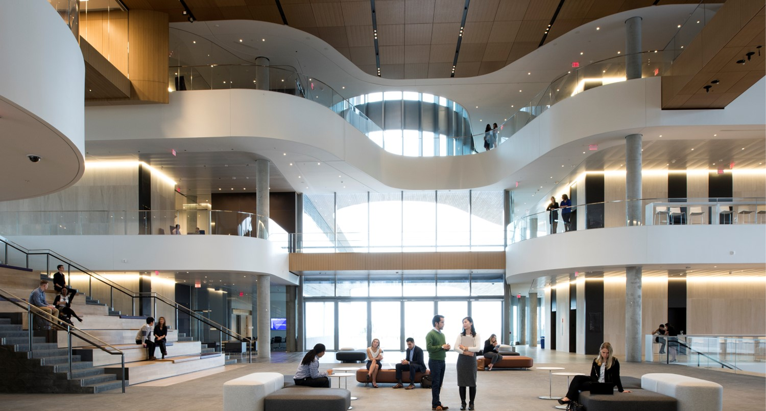
About the CMC
The CMC works year-round to connect employers with students for internship and full-time job opportunities through traditional on-campus and asynchronous, off-campus hiring.
While clubs may interact with a company to schedule a club event, the CMC stays in touch with companies year-round to build a long-term relationship that will benefit Kellogg students for years to come.

Slide 3
CMC Recruitment Events
Kellogg Networking Nights
Corporate Presentations
Recruiting-focused presentations, organized by the CMC and corporate recruiters, to showcase company-specific career opportunities for MBA students.
Recruiting-focused networking nights for companies currently recruiting or planning to recruit Kellogg talent.
Coffee Chats
Scheduled by the CMC and corporate recruiters, these one-on-one or small-group discussions give students the chance for a stellar first impression with the company and are great to include in club newsletters.
Job Postings
Hear about a role from a company rep? Put it in your club newsletter and share your contact with the CMC. We will get the role posted on the job board and build a long-term relationship with the company.
First-Year and Second-Year KNN: Monday, October 3, 2022
Second-Year-Only KNN: Monday, September 19, 2022

Slide 4
About Club Events
- Club events should broaden students' industry knowledge or deepen their understanding of key business issues.
- Recruiting-related company events focus on job openings, internship programs, and recruiting practices by company – these should be hosted by the CMC!
Club-Sponsored Company Event Examples:
Lunch & Learns
Conferences
Panel Discussions
Notes:
KNN: Check our website for dates
CP’s: When scheduling your club’s events after July 4, check Campus Groups to avoid scheduling conflicts.
Job Postings: Cut down this bullet by adding the last sentence as a note?
“Our team includes employer relations and coaching staff; we’ll distribute our contacts page at the end of this presentation.”

Slide 5
About Corporate Engagement
The Kellogg Corporate Engagement team offers resources and best practices for speaker and sponsor engagement. We provide industry connection and strategic support to create a consistent, professional experience and elevate the Kellogg brand..

Slide 6
How We Partner With You
Share company interests & align unique opportunities
Streamline corporate requests, provide outreach strategy, process invoices & track payments
Provide resources for speaker and sponsorship strategy & best practices
Vet speakers to help minimize conflicting invitations & track speaker engagements across Kellogg

Slide 7
Speakers
Plan
Schedule
Execute
Conduct initial research to identify companies and/or Kellogg alumni that are of interest to you for your event and that may be compelled to accept an invitation for your Kellogg club.
Prior to confirming the date and time with the speaker, review the Kellogg Campus Groups calendar.
Two weeks in advance, schedule & host a prep call with speaker.
Notify Corporate Engagement before inviting speakers who have a strong connection to the university, and when planning for an event with an intended audience of 100+.
5-7 days in advance, prepare any day-of materials.
Review host checklist, located on our webpage.
Invite speaker 2-3 months in advance, whenever possible.
Once confirmed, create an event page on Campus Groups, where you will be prompted to upload speaker information using this form.
Promote your event to all relevant clubs, cohorts, and programs.

Slide 8
Sponsorships
Conferences
Lunch & Learns
Panels
Other
Club Events & Sponsorship Eligibility
We're here to help. A member of the CE team would be happy to meet and discuss your strategy, budget and sponsorship plan. There are also sponsorship tools and resources on the Kellogg Serial to start you on your journey.
When developing a list of potential sponsors, utilize business contacts, recruiters, recently graduated alumni, and past organizers of your activity. Securing sponsors also takes time. Begin solicitations 2-3 months prior to the event and no less than 4 weeks beforehand.
Corporate sponsorship is reserved for professional and cultural clubs. Non-academic clubs (social, sport) are not permitted to solicit sponsorship. Sponsorship is standardized across clubs at $1,000/event.
Companies can host up to (2) events per quarter across all clubs. Multi-firm events are encouraged and do not count towards a firm’s two events.
Corporate Engagement creates and sends invoices to companies as well as follows up on outstanding invoices.

Slide 9
Resources
Confirmed Sponsor?
Send CP the Following:
Submit speaker information for all confirmed club events on Campus Groups using this form.
Speaker Engagement Tools: Speaker invitation, briefing, timelines, and communication templates.
Sponsor Solicitation Information: Sponsorship guidelines, email templates, corporate outreach best practices, etc.

Slide 10
Helpful Reminders for Club Events
Club Event Details
Club-sponsored company events should be educational
Clubs may host up to 3 events, corporate or non-corporate, per week
Companies can sponsor 2 events per quarter across all clubs. Multi-firm events are encouraged.
Timeline
Complete Speaker & Sponsor planning and outreach in the summer for prioritized fall events
Clubs can schedule events in Campus Groups July 4 and later
Avoiding Scheduling Conflicts
Check for scheduling conflicts in Kellogg Campus Groups
No events can be scheduled on Wednesdays between 12:00pm – 1:30pm
All evening weekday events must be scheduled between 5:15 PM – 6:15 PM so that they do not overlap with evening classes.

Slide 11
Questions
Career Management Center
Recruitment related corporate interactions & questions.
www.kellogg.northwestern.edu/career/
cmc@kellogg.northwestern.edu
Emails will be forwarded to the appropriate CMC contact.
Corporate Engagement
Speaker engagement resources, tracking and best practices
Corporate sponsor solicitation for lunch & learns, educational events, or conferences
Resources for inviting a speaker: link
Resources for club sponsorships: link
Speaker inquiries: speakernotice@kellogg.northwestern.edu
Sponsorship inquiries: corporatepartnerships@kellogg.northwestern.edu
Melinda Cervantes, Senior Director
Jennifer Johnson, Senior Associate Director
Allison Welton, Associate Director
Holly Carr, Associate Director
Emma Valind, Senior Program Coordinator (General Inquiries)

